Slide 1
Spark RDD 概念入門
方紹昌(Allen)
allen@is-land.com.tw

Slide 2

Recap
Last meetup
https://github.com/spark-hsinchu/spark-hands-on

Slide 3
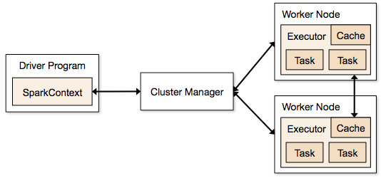
A quick review

Slide 4

SparkContext
Firstly, a Spark program must do is to create a SparkContext object, which tells Spark how to access a cluster.
To create a SparkContext, you need to build a SparkConf object that contains information about your application.

Slide 5
RDD
Resilient Distributed Datasets (RDDs)
Spark revolves around the concept of a resilient distributed dataset (RDD), which is a fault-tolerant collection of elements that can be operated on in parallel.
distributed collection of objects on anywhere
RDDs are the fundamental unit of data in Spark

Slide 6

How to create a RDD
Parallelizing
External datasets

Slide 7
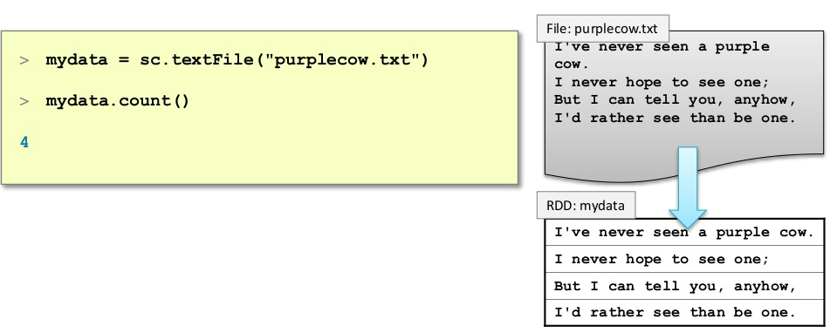
Example: A File-based RDD

Slide 8
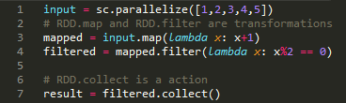
Operation on RDD
Transformations
Actions

Slide 9
Different?
Transformation
is lazy, do not compute their results right way.
create a new RDD from an existing one.
Action
compute and return results immediately.
RDD
New RDD
RDD
Result Value

Slide 10
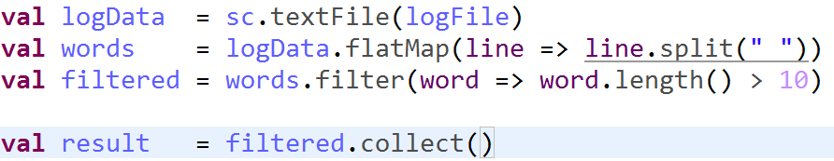
Example(1/2)

Slide 11
Example(2/2)
file
textFile
HadoopRDD
flatMap
FlatMapRDD
filter
FIlterRDD
collect
result

Slide 12
Common RDD
Transformations
map
filter
Actions
collect
count
flatMap
distinct
union
groupByKey
reduceByKey
Join
foreach
first
saveAsTextFile

Slide 13
RDD.map()
Return a new dataset formed by passing each
element of the source through a function func.
rdd.map(x => x + 1)
1, 2, 3, 3, 6
2, 3, 4, 4, 7

Slide 14
RDD.flatMap()
Similar to map, but each input item can be
mapped to 0 or more output items, but all data
only in one collection
rdd.flatMap(
x => x.split("|" )
)
"2", "3", "4", "5"
"2|3","4|5"

Slide 15
RDD.filter()
Return a new dataset formed by selecting those
elements of the source on which func returns
true.
rdd.filter(x => x > 2)
1, 2, 3, 3, 6
3, 3, 6

Slide 16
RDD.union()
Return a new dataset that contains the union of
the elements in the source dataset and the
argument.
1, 2, 3
rdd1.union(rdd2)
1,2,2,3,4
2, 4

Slide 17
RDD.distinct()
Return a new dataset that contains the distinct
elements of the source dataset.
rdd.distinct()
1, 2, 3, 3, 6
1,2,3,6

Slide 18
RDD.reduce()
Aggregate the elements of the dataset using a
function func. The function should be
commutative and associative so that it can be
computed correctly in parallel.
rdd.reduce((x, y) => x + y)
1,2,3,4
10

Slide 19
Key-Value Pair

Slide 20

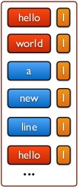
Concept

Slide 21

Create Pair RDD
Transformations on Pair RDD
reduceByKey
groupByKey
mapValues
flatMapValues
join
……

Slide 22
RDD.reduceByKey()
Returns a dataset of (K, V) pairs where the
values for each key are aggregated using the
given reduce function func
rdd.reduceByKey((x, y) => x + y)
(A,1), (B,1),
(C,1), (C,1)
(A,1), (B,1),
(C,2)

Slide 23
RDD.mapValues()
Apply a function to each value of a pair RDD
without changing the key.
(A,1), (B,1),
(C,1), (C,1)
(A,2), (B,2),
(C,2), (C,2)
rdd.mapValues(x => x+1)

Slide 24
RDD.groupByKey()
When called on a dataset of (K, V) pairs, returns
a dataset of (K, Iterable<V>) pairs.
(A,1), (B,2),
(C,3), (C,4)
rdd.groupByKey()
(A,[1]), (B,[2]),
(C,[3, 4])

Slide 25
RDD.flatMapValues()
Apply a function that returns an iterator to each
value of a pair RDD, and for each element
returned, produce a key/value entry with the old
key. Often used for tokenization.
(A,1), (B,2),
(C,3), (C,4)
rdd.flatMapValues(x => x+1)
(A,2), (B,3),
(C,4), (C,5)

Slide 26
RDD.join()
When called on datasets of type (K, V) and (K, W), returns a dataset of (K, (V, W)) pairs with all pairs of elements for each key.
(A,1), (B,2),
(C,3), (D,4)
(A,(1,4)), (D,(4,3))
rdd1.join(rdd2)
(A,4), (D,3)

Slide 27
Actions on Pair RDD
countByKey
collectAsMap
lookup(key)

Slide 28
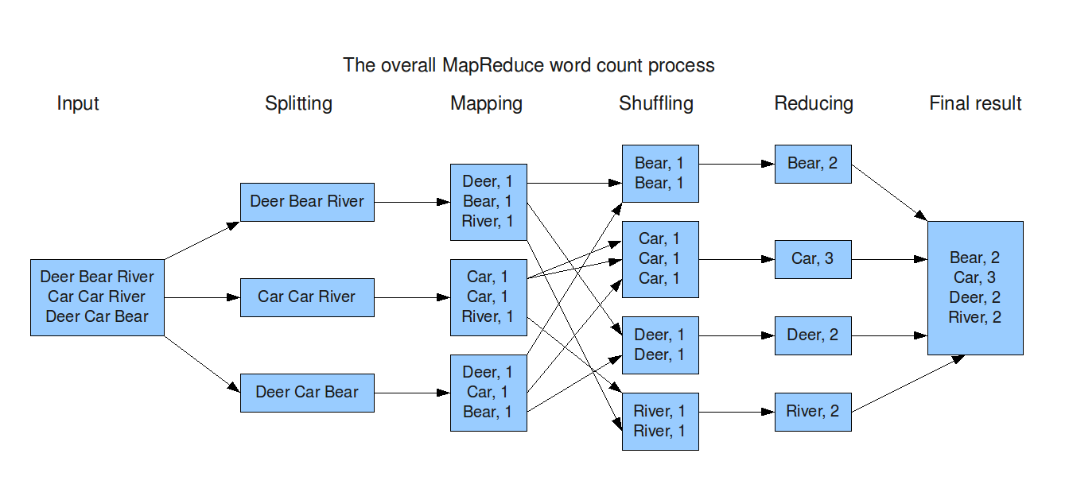
WordCount(1/3)

Slide 29
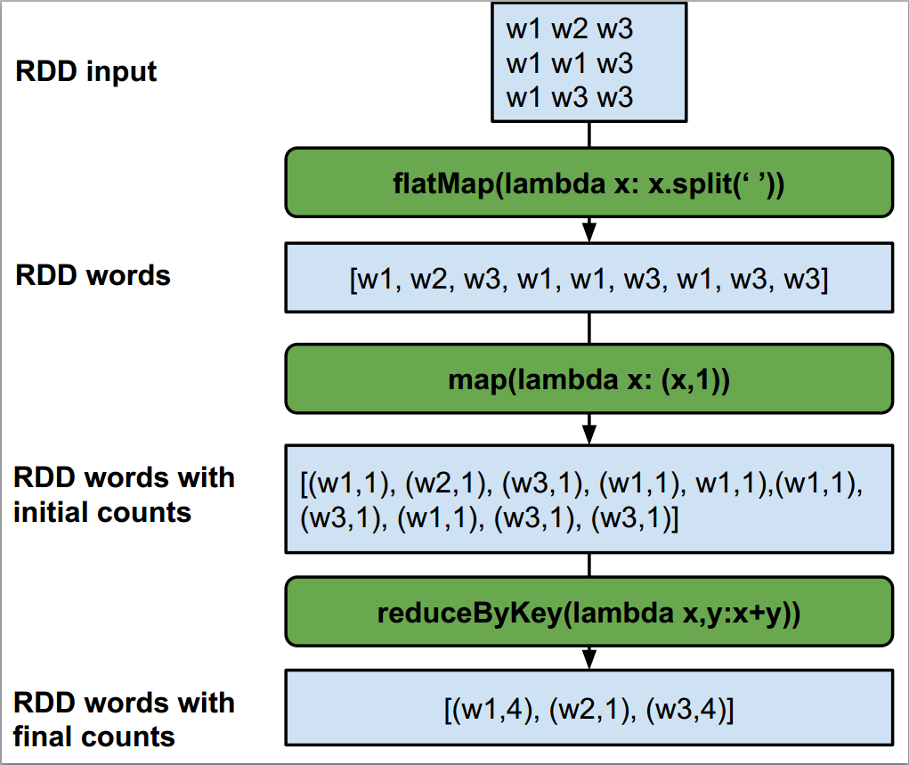
WordCount(2/3)

Slide 30
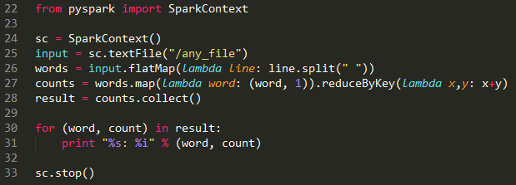
WordCount(3/3)
wordcount.py

Slide 31
Persistence(1/5)
You may wish to use the same RDD multiple times, we
can ask Spark to persist the RDD.
RDD.persist()
RDD.cache()
Spark can persist RDD in several ways
In-memory
Disk
Both

Slide 32
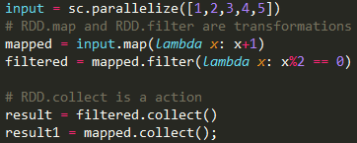
Persistence(2/5)

Slide 33
Persistence(3/5)
Job1
Input
map
MapRDD
2: collect
filter
FilterRDD
1: collect
Result
Result

Slide 34
Persistence(4/5)
Input
map
MapRDD
2: collect
filter
FilterRDD
1: collect
Result
Result
Job2

Slide 35
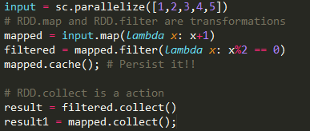
Persistence(5/5)

Slide 36
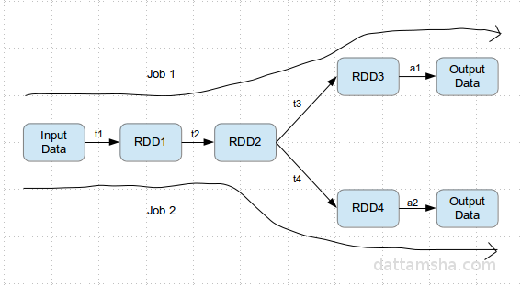
RDD Objects
When call an action in Spark, will trigger a corresponding job

Slide 37
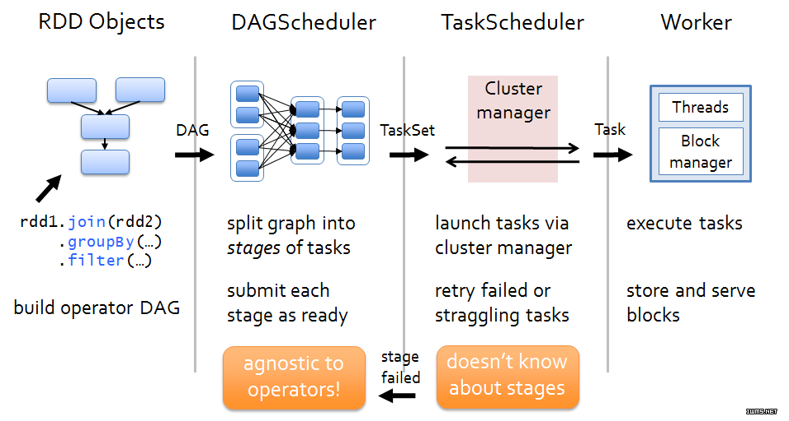
Job Scheduling Process

Slide 38
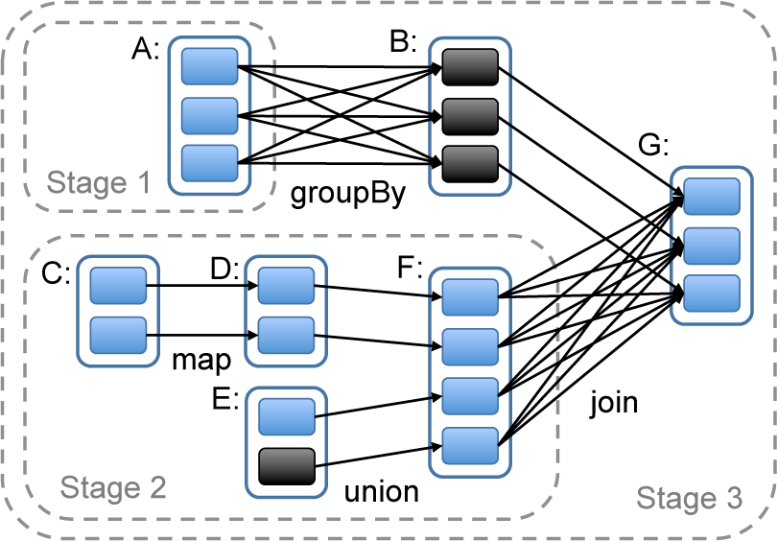
DAG

Slide 39
RDD is an Interfaces
Set of partitions
List of dependencies on parent RDDs
Function to compute a partition given its parent(s)
Partitioner (hash, range)
Preferred location(s) for each partition

Slide 40
HadoopRDD
partitions = one per HDFS block
dependencies = none
compute(part) = read corresponding block
preferredLocations(part) = HDFS block location
partitioner = none

Slide 41
FilteredRDD
partitions = same as parent RDD
dependencies = “one-to-one” on parent
compute(part) = compute parent and filter it
preferredLocations(part) = none (ask parent)
partitioner = none

Slide 42
Partitions(1/2)
I’m Allen, 27 years old
Come from Tainan City
Love Spark and Java
Graduate from NCU
Master on MBA
Work on is-land.inc
........
RDD
I’m Allen, 27 years old
Come from Tainan City
Love Spark and Java
Graduate from NCU
p1
p2
p3
p4
p5

Slide 43
Partitions(2/2)
Partition decide the level of parallelism
RDD
p1
Task1
p2
Task2
p3
Task3
p4
Task4
p5
Task5

Slide 44

The End!
Making big Data Simple
with Spark

